Slide 1
UniVideo at a Glance
UniVideo asks a simple research question with broad implications: can the unified multimodal
modeling paradigm that worked for images be extended to videos without splitting the problem
into separate systems?
• Core claim: a single framework can support video understanding, generation, and editing
under multimodal instructions.
• Research motivation: many prior video systems are task-specific, rely mainly on text-only
conditioning, or remain weak at multimodal video reasoning.
• Why this matters: video is temporally structured and often requires joint reasoning over
appearance, motion, and instruction context.
• Expected payoff: better task unification, stronger instruction following, and broader
generalization across video tasks.

Slide 2
Why Video Unification Is Hard
The central gap is not just generating video clips, but unifying understanding, generation,
and editing across text, images, and video within one multimodal system. Earlier approaches
usually solve only part of that problem.
Prior systems cover useful subproblems, but not full multimodal video unification.
System trend | What it does well | What remains missing for a unified video model
Unified multimodal models | Strong at text-image understanding and image generation | Often image-centric rather than truly video-capable
Text-to-video models | Generate videos from text prompts | Usually weak at reasoning over richer multimodal inputs such as images, video context, or mixed prompts
Video editing pipelines | Handle specific editing tasks with engineered workflows | Commonly rely on task-specific modules, masks, or custom adapters instead of one general framework

Slide 3
Core Idea: A Dual-Stream Architecture
Understanding Stream
Dual-Stream Goal
Generation Stream
• MLLM for semantic interpretation
• Reads text, images, videos
• Keeps language reasoning strong
• Builds task-aware understanding
• Supports precise editing intent
Division of labor
Reasoning + rendering
Coordinated, not isolated
Consistency across streams
• MMDiT for visual synthesis
• Generates or edits outputs
• Focuses on visual fidelity
• Handles appearance details
• Produces coherent visual results
Key requirement: cross-stream consistency for editing precision, identity preservation, and reliable alignment between intent and output

Slide 4
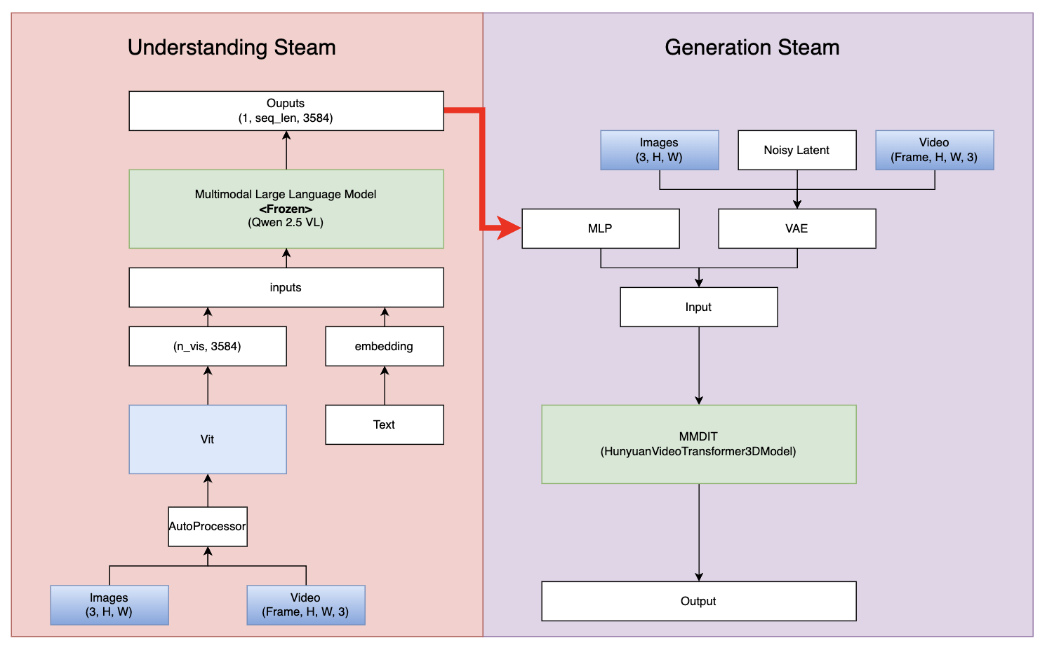

Slide 5
How UniVideo Unifies Multiple Tasks
Architecturally, the multiple visual conditions are encoded, padded to a common format, concatenated along the temporal dimension, and then processed with self-attention.
That means the model can reason over all conditions jointly instead of hard-coding a custom path for each task.
Task Type | Inputs | Process
T2I (Text to Image) | MLLM: Text MM-DIT: noisy Imgae | text → conditioning noise → denoise → Image
I2V (Image to Video) | MLLM: image + text MM-DiT: image + noisy video | image + text → conditioning noise → denoise → video
T2V (Text to video) | MLLM: Text MM-DIT: noisy video | text → conditioning noise → denoise → video
Image Editing | MLLM: image + text MM-DiT: image + noisy image | image → structure text → edit instruction noise → denoise → image
ID-V2V (Video Editing) | MLLM: video + text MM-DiT: video + noisy video | video → structure + identity text → edit instruction noise → denoise → edited video

Slide 6
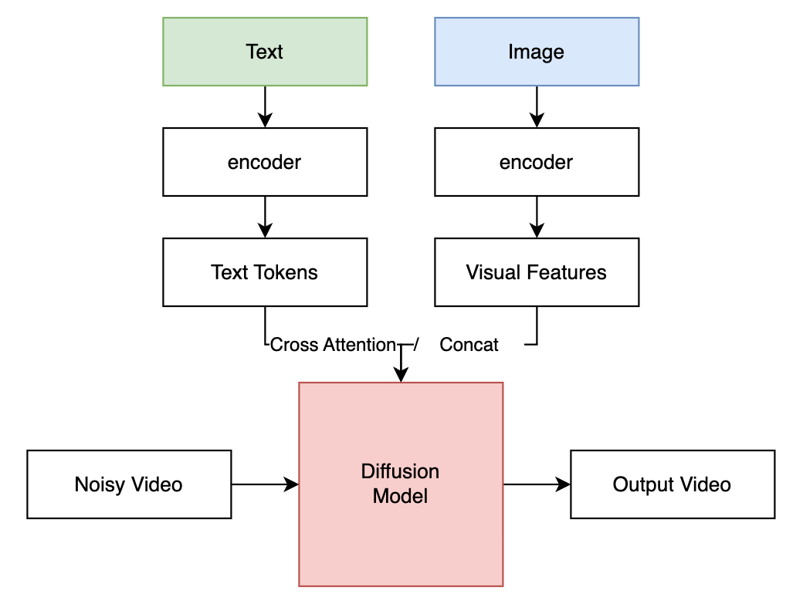
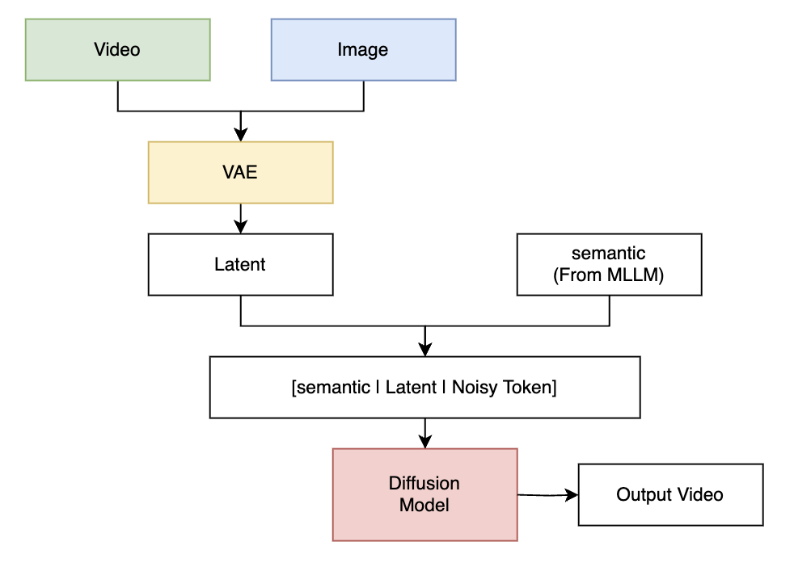
Conditioning Strategy for Video Inputs
Before
Condition Guides Generation
UniVideo
Condition Participates in Generation

Slide 7
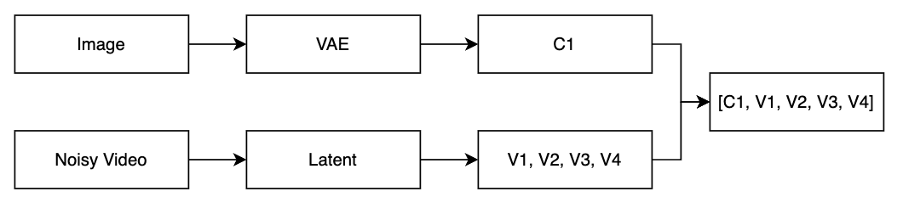
Conditioning Strategy for Video Inputs
Example: Input an Image, and produce a 4-frame video
Condition frames are treated as earlier timesteps in the video sequence.

Slide 8

Positional Embedding for UniVideo
Input to MMDIT:
Question:
If the model does not know which frame is condition, how can the model avoid to edit the conditional frame?
UniVideo: 3D Positional Encoding
(token = content + positional_embedding(t, h, w)

Slide 9
Positional Embedding for UniVideo
Content = [0.2, -1.3, ...]
(t=2, h=10, w=20)
embedding = content + pos_t(2) + pos_h(10) + pos_w(20)
- Each token is encoded with a 3D position (t, h, w).
- Temporal position is embedded into the token, not provided as a separate input.
- This allows the model to distinguish condition frames from target frames.

Slide 10
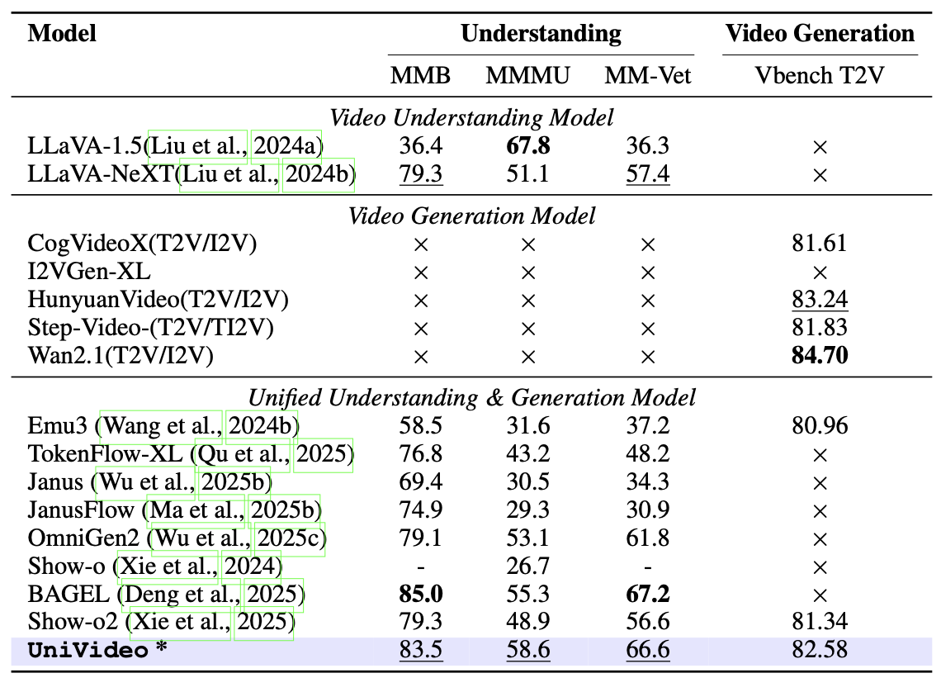
Main Results: Understanding and Generation

Slide 11
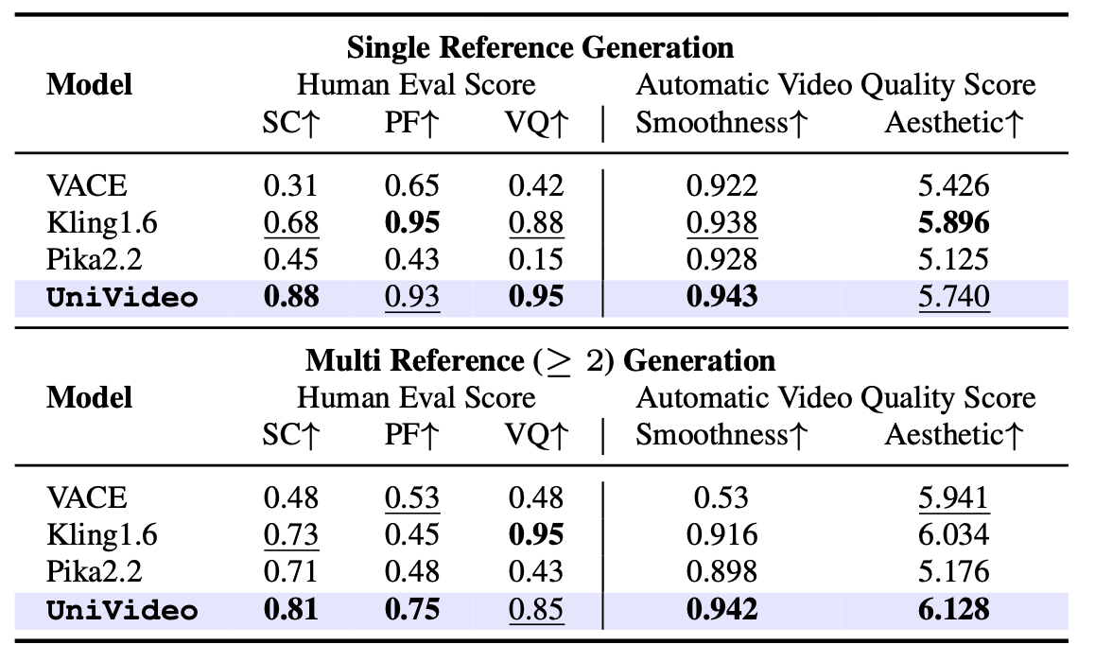
In-Context Video Generation Results

Slide 12
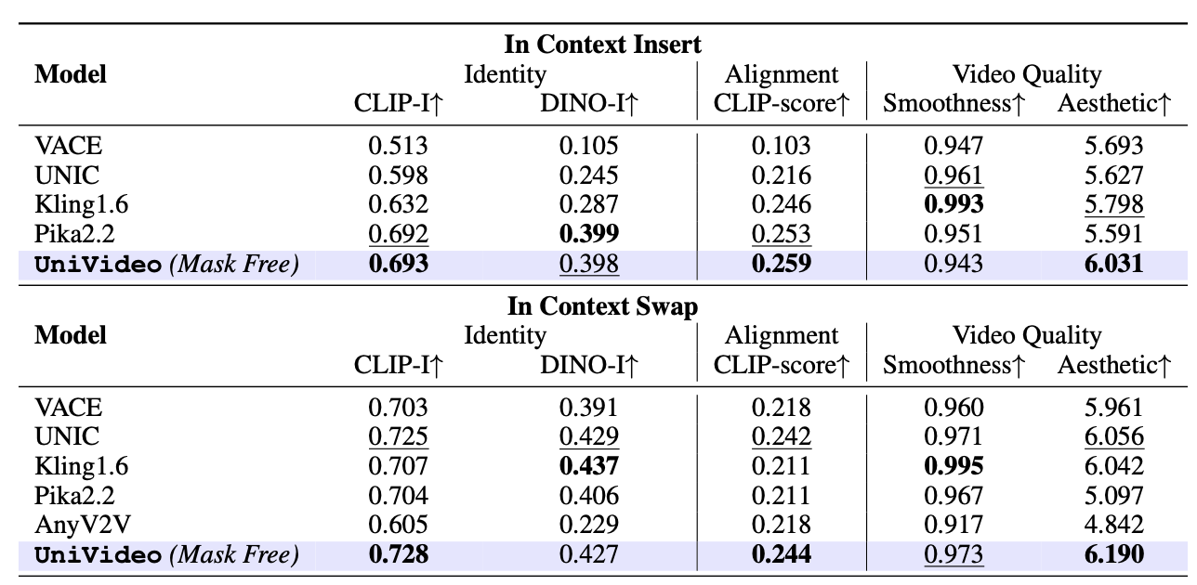
In-Context Video Editing Results

Slide 13
Conclusion
Main Contribution
Key Strength
• A unified framework for video understanding, generation, and editing
• Reformulates generation as multimodal token modeling
• Introduces MMDiT with joint self-attention across conditions and targets
• Enables mask-free in-context video editing
• Strong multimodal alignment with frozen MLLM
• Handles diverse tasks with one shared architecture
• Effective use of multiple visual conditions
• Better instruction following and consistency
Limitations
• Relies on latent (2D) representation, limited 3D reasoning
• Performance depends on MLLM quality and alignment
• High computational cost for long video sequences
• Still limited in fine-grained control / precision editing

Slide 14
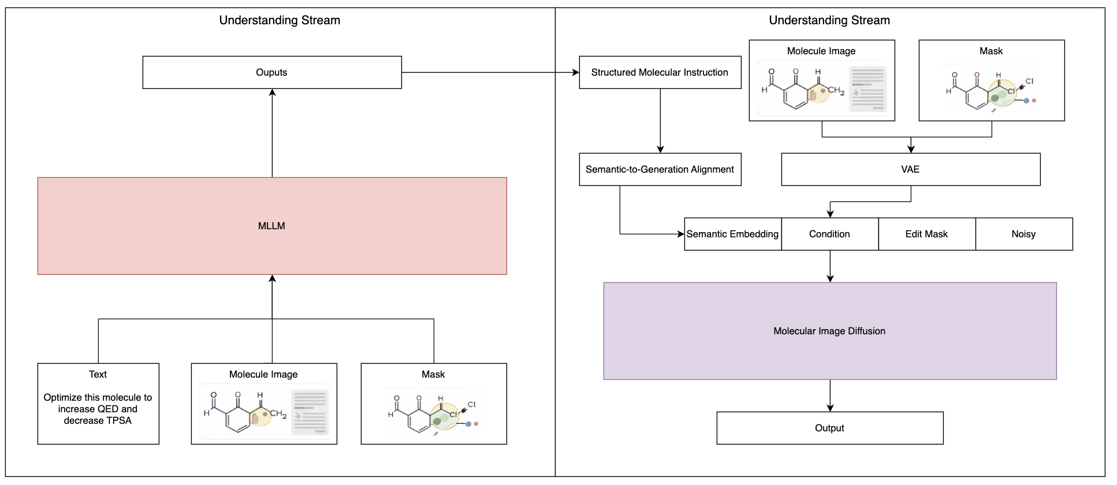
Combine with SketchMol

